Slide 1
IBM Data Science
Capstone Project

Slide 2
Introduction:
In the Final Capstone project, we are going to explore neighborhoods in Calgary, Alberta Canada. We will explore how restaurants are distributed across different neighborhoods of Calgary. Data visualization for different restaurants across different parts of Calgary will help determine potential entrepreneurs to decide which part(s) of Calgary could be considered to for opening a restaurant. This project brings together solid data analysis and visualization to serves as a good initial basis for any entrepreneur in the food and services industry
Data:
The neighborhood data that we are going to use will be retrieved from Wikipedia. Using the neighborhood data from wiki, we the used it to get the latitude and longitude of the neighborhoods

Slide 3
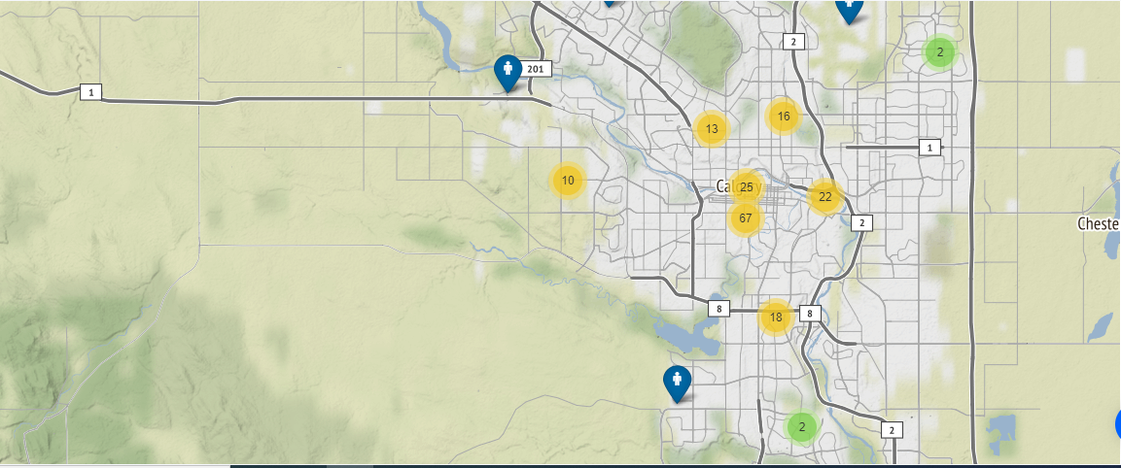
Methodology:
List of Calgary Neighborhoods was collected from Wikipedia using web scraping technique
Using geopy package, latitude and longitude were extracted from the data
The latitude and longitude were used in foursquare API to get the venues’ information
Restaurants’ information was extracted from the venue’s information
Data analysis and visuals provided to better understand the distributed of restaurants in Calgary. Folium with enhanced features were used to create map

Slide 4
Results and Conclusion:
Results show that there are many areas of Calgary that there are very few restaurants. Entrepreneurs should take the advantage of this fact and start to research the amount of cost, populations, best suited cuisine and start something. This will not only help them but also to the people of the community who look to go out to different places for dinner.

